Slide 1


CSCE 5640 Operating System Design Deadlocks
Dr. Amar Maharjan
Computer Science and Engineering
University of North Texas
Slides (with some modifications) from:
Operating System Concepts 10 edition – Silberschatz, Galvin and Gagne © 2018

Slide 2
Outline
System Model
Deadlock Characterization
Methods for Handling Deadlocks
Deadlock Prevention
Deadlock Avoidance
Deadlock Detection
Recovery from Deadlock

Slide 3
System Model
System consists of a finite number of resources to be distributed among a number of competing threads.
Resource types R₁, R₂, . . ., R_{m}
CPU cycles, memory space, I/O devices
Each resource type R_{i} has W_{i} instances.
Each process utilizes a resource as follows:
request
use
release
Notes:
Examples are the request() and release() of a device, open() and close() of a file, and allocate() and free() memory system calls.
We have finite resources. Each resource type may have multiple instances, Ex, Printer -3, Memory space, Network instance-2, etc.

Slide 4
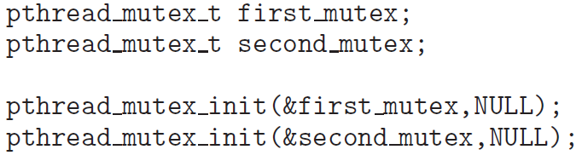
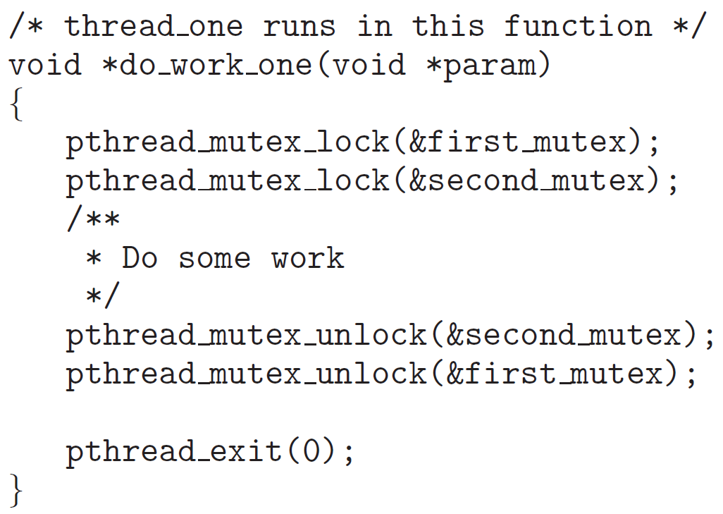
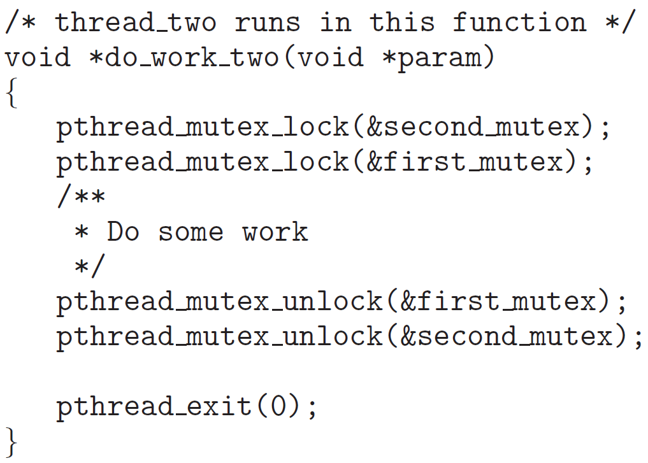
Deadlock in Multithreaded Applications
Notes:
Pthread_mutex_t: Data structure
This may or may not be in a deadlock; It depends on order.

Slide 5
Livelock
Another form of liveness failure. It is similar to deadlock; both prevent two or more threads from proceeding, but the threads are unable to proceed for different reasons.
Occurs when a thread continuously attempts an action that fails.
Livelock is similar to what sometimes happens when two people attempt to pass in a hallway:
One moves to his right, the other to her left, still obstructing each other’s progress.
Then he moves to his left, and she moves to her right, and so forth.
They aren’t blocked, but they aren’t making any progress.
Livelock is less common than deadlock but nonetheless is a challenging issue in designing concurrent applications, and like deadlock, it may only occur under specific scheduling circumstances
Notes:
It's not exactly deadlock, but it’s a kind of failure.
Threads, Tasks, and Process are interchangeable.

Slide 6
Deadlock Characterization
Deadlock can arise if four conditions hold simultaneously.
Mutual exclusion: only one thread at a time can use a resource
Hold and wait: a thread holding at least one resource is waiting to acquire additional resources held by other threads
No preemption: a resource can be released only voluntarily by the thread holding it, after that thread has completed its task
Circular wait: there exists a set {T₀, T₁, …, T_{n}} of waiting threads such that T₀ is waiting for a resource that is held by T₁, T₁ is waiting for a resource that is held by T₂, …, T_{n–1} is waiting for a resource that is held by T_{n}, and T_{n} is waiting for a resource that is held by T₀.
Notes:
Arise when a certain condition is held.
If we don’t want any of these conditions, then we will not have a deadlock.
If anyone is broken, then deadlock will not occur.

Slide 7
Resource-Allocation Graph
V is partitioned into two types:
T = {T₁, T₂, …, T_{n}}, the set consisting of all the threads in the system.
R = {R₁, R₂, …, R_{m}}, the set consisting of all resource types in the system
request edge – directed edge T_{i} → R_{j}
assignment edge – directed edge R_{j} → T_{i}
Notes:
T: Set of processes.
M number of resources (R)
R1 can be a printer, which can be 1,2,3, etc
If Ti → Rj; Ti thread is trying to access one resource of Rj.
Rj→ Ti: Rj has been assigned to thread Ti.

Slide 8
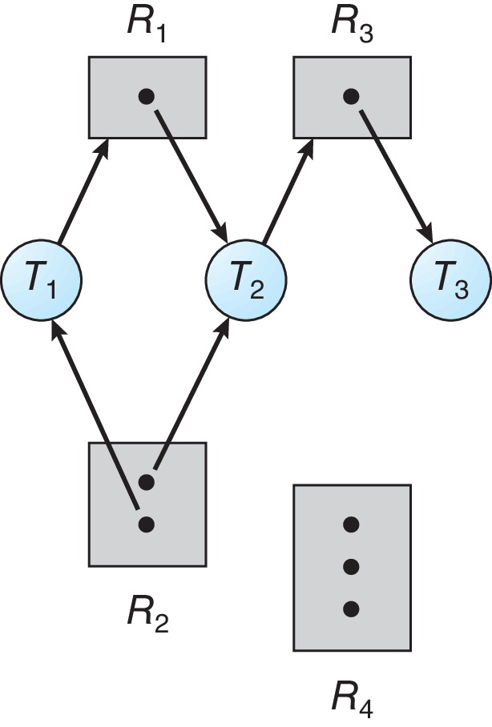
Resource Allocation Graph Example
One instance of R₁
Two instances of R₂
One instance of R₃
Three instance of R₄
T₁ holds one instance of R₂ and is waiting for an instance of R₁
T₂ holds one instance of R₁, one instance of R₂, and is waiting for an instance of R₃
T₃ is holds one instance of R₃
Notes:
The number of dots is the number of instances.
Nobody requested or has been assigned R4.
There is no cycle.

Slide 9
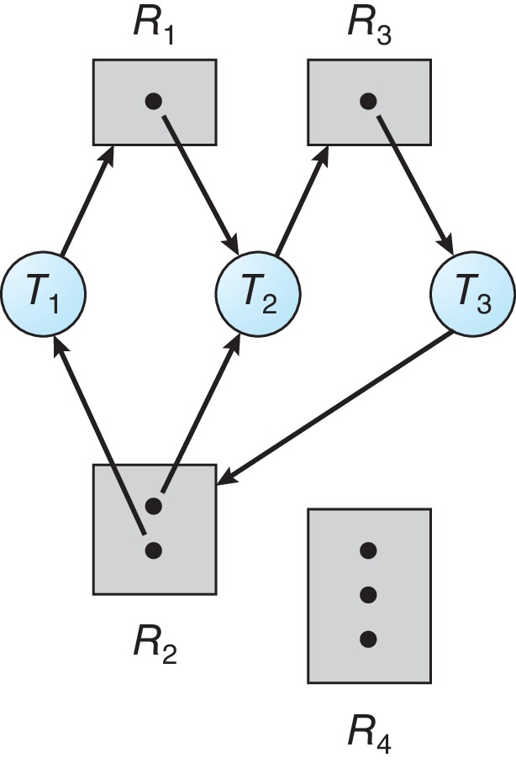
Resource Allocation Graph with a Deadlock
Notes:
Here we have a cycle; we have 2 cycles.
There is a possibility of deadlock.

Slide 10
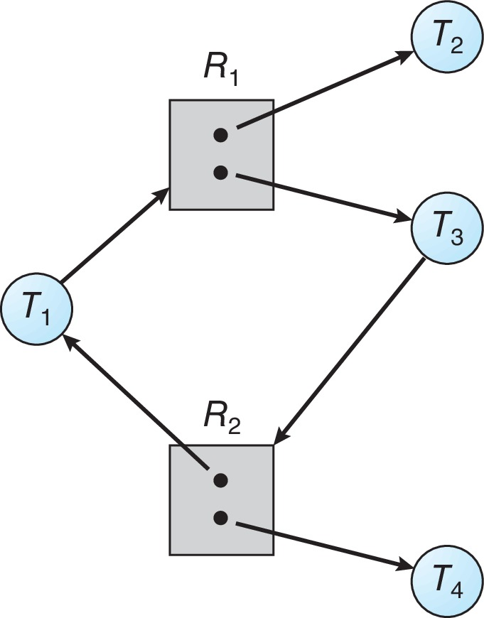
Graph with a Cycle But no Deadlock
There is no deadlock.
Observe that thread T₄ may release its instance of resource type R₂.
That resource can then be allocated to T₃, breaking the cycle.
Notes:
The cycle is not compulsory to be in a deadlock.
There is no deadlock here, even though we have a cycle.

Slide 11
Basic Facts
If graph contains no cycles ⇒ no deadlock
If graph contains a cycle ⇒
if only one instance per resource type, then deadlock
if several instances per resource type, possibility of deadlock

Slide 12
Methods for Handling Deadlocks
Ensure that the system will never enter a deadlock state:
Deadlock prevention
Ensure that at least one of the necessary conditions cannot hold.
Deadlock avoidance
Requires that the OS be given additional information in advance concerning which resources a thread will request and use during its lifetime.
Then, the OS can decide for each request whether or not the thread should wait.
Allow the system to enter a deadlock state and then recover
Ignore the problem and pretend that deadlocks never occur in the system.
Notes:
4 necessary conditions.
Avoidance: Collect information about the thread, we check the before granting the resource.
If we grant the resource, then it will be in a deadlock we will not grant it. It's kind of a future prediction. For this, we need extra tentative information.

Slide 13
Deadlock Prevention
Invalidate one of the four necessary conditions for deadlock:
Mutual Exclusion – not required for sharable resources (e.g., read-only files); must hold for non-sharable resources
Hold and Wait – must guarantee that whenever a thread requests a resource, it does not hold any other resources
Require threads to request and be allocated all its resources before it begins execution or allow thread to request resources only when the thread has none allocated to it.
Low resource utilization; starvation possible
Notes:
In certain conditions, we can avoid mutual exclusion. Ex: If all the processes are reading the file, no process is writing.

Slide 14
Deadlock Prevention (contd.)
No Preemption:
If a process that is holding some resources requests another resource that cannot be immediately allocated to it, then all resources currently being held are released
Preempted resources are added to the list of resources for which the thread is waiting
Thread will be restarted only when it can regain its old resources, as well as the new ones that it is requesting
Circular Wait:
Impose a total ordering of all resource types, and require that each thread requests resources in an increasing order of enumeration
Notes:
We can break the circular wait in one particular instance.
We will assign the instances a unique number.
Each thread will require the resources in increasing order. They cannot get resources not in increasing order.
If we can implement this algorithm we can break the circular wait.

Slide 15
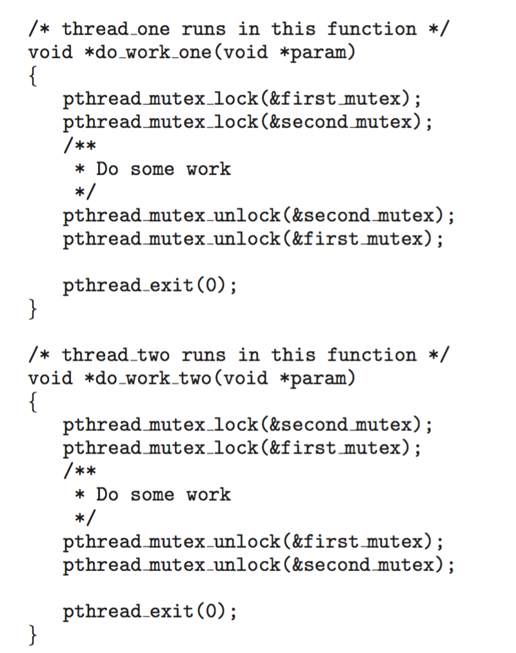
Circular Wait
Invalidating the circular wait condition is most common.
Simply assign each resource (i.e., mutex locks) a unique number.
Resources must be acquired in order.
If: first_mutex = 1 second_mutex = 5 code for thread_two could not be written as follows:
Notes:
The right program violates the increasing order of resource numbers. So, as a programmer, we should not write in this way

Slide 16
Deadlock Avoidance
Requires that the system has some additional a priori information available
Simplest and most useful model requires that each thread declare the maximum number of resources of each type that it may need
The deadlock-avoidance algorithm dynamically examines the resource-allocation state to ensure that there can never be a circular-wait condition
Resource-allocation state is defined by the number of available and allocated resources, and the maximum demands of the threads

Slide 17
Safe State
When a thread requests an available resource, system must decide if immediate allocation leaves the system in a safe state
System is in safe state if there exists a sequence <T₁, T₂, …, T_{n}> of ALL the threads in the systems such that for each T_{i}, the resources that T_{i} can still request can be satisfied by currently available resources + resources held by all the T_{j}, with j < i
That is:
If T_{i} resource needs are not immediately available, then T_{i} can wait until all T_{j} have finished
When T_{j} is finished, T_{i} can obtain needed resources, execute, return allocated resources, and terminate
When T_{i} terminates, T_{i +1} can obtain its needed resources, and so on
Notes:
T2 will execute with all the resources that it has and the resources that are released by T1 (After T1 has executed).
Can we identify the order? - <T1, T2,…., Tn>

Slide 18
Basic Facts
If a system is in safe state ⇒ no deadlocks
If a system is in unsafe state ⇒ possibility of deadlock
Avoidance ⇒ ensure that a system will never enter an unsafe state.

Slide 19
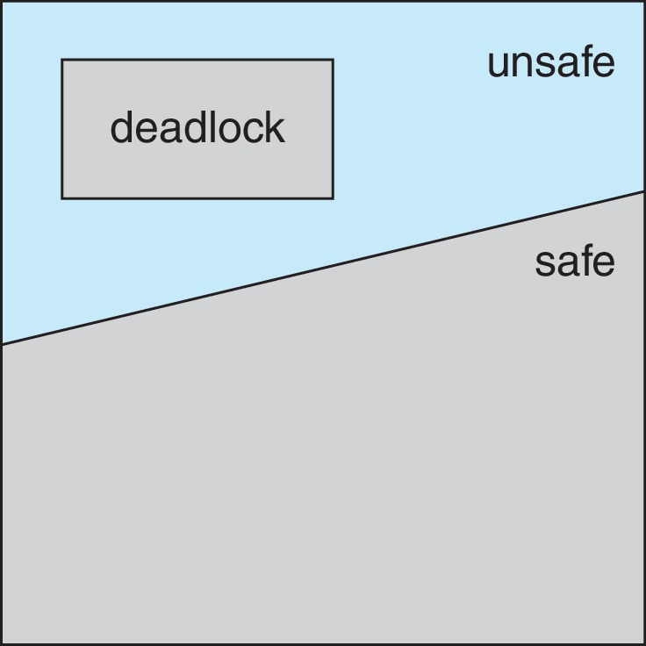
Safe, Unsafe, Deadlock State

Slide 20
Avoidance Algorithms
Single instance of a resource type
Use a resource-allocation graph
Multiple instances of a resource type
Use the Banker’s Algorithm

Slide 21
Resource-Allocation Graph Scheme
Claim edge T_{i} → R_{j} indicated that process T_{j} may request resource R_{j}; represented by a dashed line
Claim edge converts to request edge when a thread requests a resource
Request edge converted to an assignment edge when the resource is allocated to the thread
When a resource is released by a thread, assignment edge reconverts to a claim edge
Resources must be claimed a priori in the system
Notes:
Claim edge: Dotted line.
May request resources in the future.

Slide 22
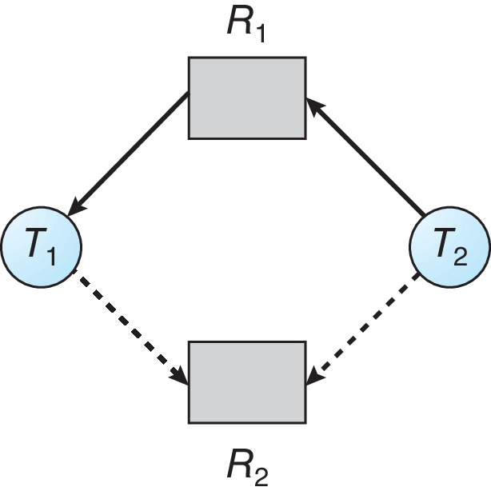
Resource-Allocation Graph

Slide 23
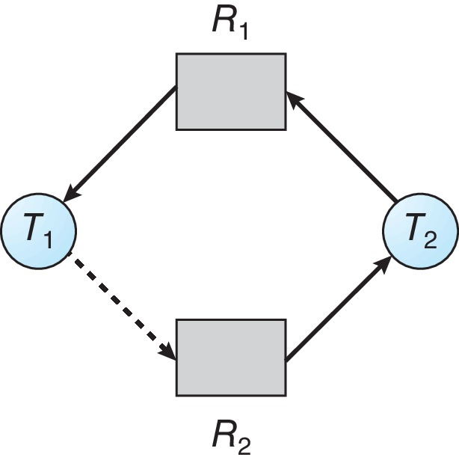
Unsafe State In Resource-Allocation Graph
Suppose T₂ requests R₂ and allocated, and T₁ requests R₂.
This will create a deadlock.
Notes:
This works only if each resource has only one instance.
T1 → R2 will not be granted because if it is granted then it will be a cycle and it will be in a deadlock.

Slide 24
Resource-Allocation Graph Algorithm
Suppose that thread T_{i} requests a resource R_{j}
The request can be granted only if converting the request edge to an assignment edge does not result in the formation of a cycle in the resource allocation graph

Slide 25
Banker’s Algorithm
Multiple instances of resources
Each thread must declare a priori claim of maximum use
When a thread requests a resource, it may have to wait
When a thread gets all its resources it must return them in a finite amount of time
Notes:
The name was chosen because the algorithm could be used in a banking system to ensure that the bank never allocated its available cash in such a way that it could no longer satisfy the needs of all its customers.
It should know how many resources are available, how many are allocated, how many are in demand, etc.
We need certain data types to hold all information. We will use a matrix.

Slide 26
Data Structures for the Banker’s Algorithm
Let n = number of processes, and m = number of resources types.
Available: Vector of length m. If Available[j] = k, there are k instances of resource type R_{j} available
Max: n x m matrix. If Max[i,j] = k, then process T_{i} may request at most k instances of resource type R_{j}
Allocation: n x m matrix. If Allocation[i,j] = k then T_{i} is currently allocated k instances of R_{j}
Need: n x m matrix. If Need[i,j] = k, then T_{i} may need k more instances of R_{j} to complete its task
Need [i,j] = Max[i,j] – Allocation [i,j]
Let X and Y be vectors of length n. We say that X ≤ Y if and only if X[i] ≤ Y[i] for all i = 1, 2, ..., n. For example, if X = (1,7,3,2) and Y = (0,3,2,1), then Y ≤ X. In addition, Y < X if Y ≤ X and Y ≠ X.
Notes:
A[2] = 5; We have 5 instances of resource 2.
n → No of process, m → Number of resource types.
Max: Maximum demand for each process.
Allocated[i,j] = k; k instances are allocated of resource j to process i.
Need: How many are required to complete?

Slide 27
Safety Algorithm
Let Work and Finish be vectors of length m and n, respectively. Initialize:
Work = Available
Finish [i] = false for i = 0, 1, …, n- 1
Find an i such that both:
(a) Finish [i] = false
(b) Need_{i} ≤ Work
If no such i exists, go to step 4
Work = Work + Allocation_{i} Finish[i] = true go to step 2
If Finish [i] == true for all i, then the system is in a safe state
Notes:
This algorithm will be used by the banker’s algorithm.
If we grant the resource will there be safety or not? – Can we generate the sequence of not?
m: resources, n: number of processes.
The finish is a boolean value: Finished or not?
The main aim is to find the safe sequence.

Slide 28
Resource-Request Algorithm for Process P_{i}
Request_{i} = request vector for process T_{i}. If Request_{i} [j] = k then process T_{i} wants k instances of resource type R_{j}
If Request_{i} ≤ Need_{i} go to step 2. Otherwise, raise error condition, since process has exceeded its maximum claim
If Request_{i} ≤ Available, go to step 3. Otherwise, T_{i} must wait, since resources are not available
Pretend to allocate requested resources to T_{i} by modifying the state as follows:
Available = Available – Request_{i};
Allocation_{i} = Allocation_{i} + Request_{i};
Need_{i} = Need_{i} – Request_{i};
If safe ⇒ the resources are allocated to T_{i}
If unsafe ⇒ T_{i} must wait, and the old resource-allocation state is restored
Notes:
This is a banker’s algorithm.

Slide 29
Example of Banker’s Algorithm
5 threads T₀ through T₄;
3 resource types:
A (10 instances), B (5 instances), and C (7 instances)
Snapshot of the current state of the system:
Allocation Max Available
A B C A B C A B C
T₀ 0 1 0 7 5 3 3 3 2
T₁ 2 0 0 3 2 2
T₂ 3 0 2 9 0 2
T₃ 2 1 1 2 2 2
T₄ 0 0 2 4 3 3
Notes:
IMPORTANT FOR EXAM
Allocation + Available = Total resources.

Slide 30
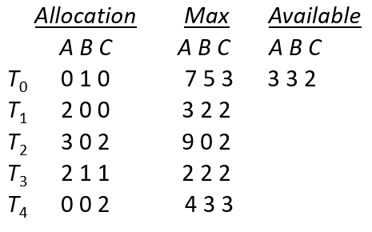
Example (contd.)
The content of the matrix Need is defined to be Max – Allocation
Need
A B C
T₀ 7 4 3
T₁ 1 2 2
T₂ 6 0 0
T₃ 0 1 1
T₄ 4 3 1
The system is in a safe state since the sequence < T₁, T₃, T₄, T₂, T₀> satisfies safety criteria
Notes:
Work = (3, 3, 2)
Finish = [F T F F F]
Work = (5, 3, 2)
Finish = [F T F T F]
Work = (7, 4, 3)
Finish = [F T F T T]
Work = (7, 4, 5)
Finish = [F T F T T]
Work = (7, 5, 5)
Finish = [T T F T T]
Work = (10, 5, 7)
Finish = [T T T T T]
Sequence →T1, T3, T4,, T0, T2

Slide 31
Example: T₁ Request (1,0,2)
Check that Request ≤ Available (that is, (1,0,2) ≤ (3,3,2) ⇒ true
Allocation Need Available
A B C A B C A B C
T₀ 0 1 0 7 4 3 2 3 0(3,3,2)
T₁ 3 0 2(2,0,0) 0 2 0 (1,2,2)
T₂ 3 0 2 6 0 0
T₃ 2 1 1 0 1 1
T₄ 0 0 2 4 3 1
Executing safety algorithm shows that sequence < T₁, T₃, T₄, T₀, T₂> satisfies safety requirement
Can request for (3,3,0) by T₄ be granted?
Can request for (0,2,0) by T₀ be granted?
Notes:
Yes, we can generate the sequence.
Ans 1:
Allocation: (0,0,2)+(3,3,0)=(3,3,2)
Need: (4,3,1)-(3,3,0)=(1,0,1)
Aval: (3,3,2)-(3,3,0)=(0,0,2)
W = Aval : (0,0,2)
Finish = [FFFFF]
T0: (7,4,3)<=(0,0,2) : No
T1: (0,2,0)<=(0,0,2) : No
T2: No
T3: No
T4: No
T5: No
We cannot generate. There are no enough resources. So this will not be granted.
Ans 2:

Slide 32
Deadlock Detection
If a system does not employ either a deadlock-prevention or a deadlock-avoidance algorithm, then a deadlock may occur.
In this situation:
An algorithm that examines the state of the system to determine whether a deadlock has occurred
An algorithm to recover from the deadlock

Slide 33
Single Instance of Each Resource Type
Maintain wait-for graph
Nodes are threads
T_{i} → T_{j} if T_{i} is waiting for T_{j}
Periodically invoke an algorithm that searches for a cycle in the graph. If there is a cycle, there exists a deadlock
An algorithm to detect a cycle in a graph requires an order of n² operations, where n is the number of vertices in the graph
Notes:
It only works if we have only one instance of each resource type.
It's not easy to implement because it takes O(n²).

Slide 34
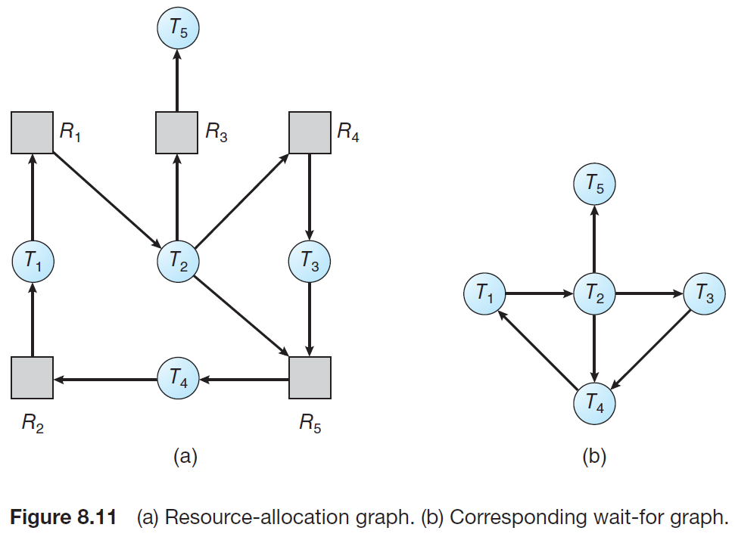
Resource-Allocation Graph and Wait-for Graph
Notes:
Threads(T) and resources (R).
No dot because there is only one instance of each resource.
2 cycles: (T1, T2, T3, T4), and (T1, T2, T4)
At least one cycle: So there is a deadlock.

Slide 35
Several Instances of a Resource Type
Available: A vector of length m indicates the number of available resources of each type
Allocation: An n x m matrix defines the number of resources of each type currently allocated to each thread.
Request: An n x m matrix indicates the current request of each thread. If Request [i][j] = k, then thread T_{i} is requesting k more instances of resource type R_{j}.
Notes:
Here, the request is a collective request for all the processes, which is a matrix nxm.

Slide 36
Detection Algorithm
Let Work and Finish be vectors of length m and n, respectively Initialize:
Work = Available
For i = 0,1,2, …, n-1, if Allocation_{i} ≠ 0, then Finish[i] = false; otherwise, Finish[i] = true
Find an index i such that both:
Finish[i] == false
Request_{i} ≤ Work
If no such i exists, go to step 4
Work = Work + Allocation_{i} Finish[i] = true go to step 2
If Finish[i] == false, for some i, 1 ≤ i ≤ n, then the system is in deadlock state. Moreover, if Finish[i] == false, then T_{i} is deadlocked
Notes:
The algorithm requires an order of O(m x n2) operations to detect whether the system is in a deadlocked state.
Almost similar to the safety algorithm, but not completely the same.
If all Finsh[i] = true in the last step, then it's safe. If at least one is false, then there is a deadlock.

Slide 37
Example of Detection Algorithm
Five threads T₀ through T₄; three resource types
A (7 instances), B (2 instances), and C (6 instances)
Snapshot of the current state of the system:
Allocation Request Available
A B C A B C A B C
T₀ 0 1 0 0 0 0 0 0 0
T₁ 2 0 0 2 0 2
T₂ 3 0 3 0 0 0
T₃ 2 1 1 1 0 0
T₄ 0 0 2 0 0 2
Sequence <T₀, T₂, T₃, T₁, T₄> will result in Finish[i] = true for all i
Notes:
When do we execute this algorithm? We don’t know, maybe every 5 minutes, we run to check for deadlock.

Slide 38
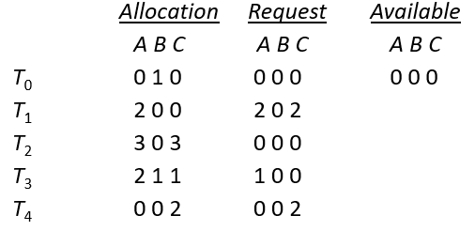
Example (contd.)
T₂ requests an additional instance of type C
Request
A B C
T₀ 0 0 0
T₁ 2 0 2
T₂ 0 0 1
T₃ 1 0 0
T₄ 0 0 2
State of system?
Can reclaim resources held by thread T₀, but insufficient resources to fulfill other processes; requests
Deadlock exists, consisting of processes T₁, T₂, T₃, and T₄

Slide 39
Detection-Algorithm Usage
When, and how often, to invoke depends on:
How often a deadlock is likely to occur?
How many processes will need to be rolled back?
one for each disjoint cycle
If detection algorithm is invoked arbitrarily, there may be many cycles in the resource graph and so we would not be able to tell which of the many deadlocked threads “caused” the deadlock.
Notes:
Arbitrarily means randomly.
To recover from deadlock, we can
Kill the process – Which thread to kill?
Reclaim the resources that have been acquired by the processes which are in a deadlock situation.

Slide 40
Recovery from Deadlock: Process Termination
Abort all deadlocked threads
Abort one process at a time until the deadlock cycle is eliminated
In which order should we choose to abort?
Priority of the thread
How long has the thread computed, and how much longer to completion
Resources that the thread has used
Resources that the thread needs to complete
How many threads will need to be terminated
Is the thread interactive or batch?
Notes:
Interactive: GUI thread
Batch: Background running thread.

Slide 41
Recovery from Deadlock: Resource Preemption
Selecting a victim – minimize cost
Cost factors may include such parameters as the number of resources a deadlocked process is holding and the amount of time the process has thus far consumed.
Rollback – return to some safe state, restart the thread for that state
Starvation – same thread may always be picked as victim, include number of rollback in cost factor

